Slide 1
STATISTICAL METHODS
FORM 1

Slide 2

STATISTICAL METHODS
CONTENT
Definition of statistics
Types and nature of statistical data
Sources of statistical data
Methods of collecting data
Methods of recording data
Analyzing data
Data presentation
Importance of studying statistics

Slide 3
STATISTICS: These are facts and figures collected and arranged in a systematic manner for a particular purpose.
It is an art or science concerned with interpretation of numerical information.
DATA: It refers to information.
So, Statistical data means information presented in numerical form in an organized manner.
STATISTICAL METHODS: These are techniques of collecting, recording, analyzing, presenting and interpreting statistical data from which conclusions are drawn from it.

Slide 4
Types of statistical data
Nature of statistical data
Primary data: These are facts and figures collected from the field as first hand information/original data e.g. counting, direct observation, carrying out an experiment
Secondary data: These are facts and figures which are collected and are available in ‘stored’ sources e.g. magazines, textbooks
A. Discrete data: These are figures given in whole numbers e.g. 35 students
B. Continuous data: These are figurers given in any values i.e. fractions(22¾ kms) or decimals(22.75 kms)

Slide 5
Sources of statistical data
Primary data
Secondary data
Direct observation
Interviewing
Measuring
Counting
Photographing
Publications e.g. newspapers, maps, journals.
Tapes/DVDs/films

Slide 6
Methods(techniques) of collecting data
Methods(techniques) of recording data
Direct observation
Interviewing e.g. face-face, telephone
Administering a questionnaire
Taking measurements e.g. height of students
Carrying out an experiment e.g. soil pH
Counting e.g. population census
Obtaining data from secondary sources(content analysis)
Sampling-selection of a representative portion
It involves storing information somewhere for future reference
Notes taking in a book
Tape/video recording; sound recording using phones
Tabulating(recording data in form of tables e.g. traffic flow)
Field sketching(drawing sketch diagrams)
Labeling photographs
Labeling of samples e.g. rocks, soil type
Tallying(use of strokes IIII i.e. 5)
Filling in a questionnaire

Slide 7

Methods/techniques of collecting data
[Description /Explanation]

Slide 8
DIRECT OBSERVATION It involves direct visual observation of geographical phenomena e.g. field study on rocks, wildlife, soil.
Merits of direct observation
Demerits of direct observation
It provides first hand information
Data obtained is reliable
It saves time
Method is subjective i.e. observer may be biased
It is an expensive method
It can’t be used during extreme weather conditions
It is ineffective for the visual impaired
It is unsuitable for collecting data on past activities

Slide 9
INTERVIEWING It is a direct conversation between the researcher and the respondent. It may be face to face or through the phone.
Merits of interviews
Demerits of interviews
It is easy to get clarification
Researcher can estimate accuracy of responses
It is easy to obtain data even from the illiterate
Provides first hand information
Language differences between the researcher and the respondent
It is an expensive method
It is time consuming

Slide 10
TAKING MEASUREMENTS This is done in the field using various methods like pacing in land surveying; estimating distance; using instruments like meter ruler, thermometer etc.
Merits of measuring
Demerits of measuring
It is a faster method of collecting data
Accurate data is obtained
It is easy to measure and take the readings
First hand information is collected
It may require skills to take the measurements
Inaccurate reading of measurements may occur
Errors when measuring may take place
It can’t be done in the absence of instruments

Slide 11
EXPERIMENTATION It is the act of conducting a test or an investigation to provide an evidence for or against a theory e.g. pH of soil, chemical composition of a rock
Merits of experimentation
Demerits of experimentation
Researcher obtains first hand information
It provides accurate data when properly conducted
It may lead to more discoveries
It is expensive since it involves use of expensive instruments
It is time consuming
It requires skills to do it
It may give false data where instruments are defective

Slide 12

CONTENT ANALYSIS It involves gathering information from secondary sources i.e. from past publications and official records e.g. textbooks, maps, journals e.t.c.
Merits of content analysis
Demerits of content analysis
It is easy to collect data
It is a cheap method
Past information is easily available
Data may appear in an inappropriate format
Data may be outdated
Data could be inaccurate
Data could be biased

Slide 13
SAMPLING
A sample is a representative of a whole. It is selected from a population to test a hypothesis.
So sampling is the process by which a representative portion of a phenomena under research is selected for analysis.
There are three main types of sampling techniques namely:
Random
Systematic
Stratified

Slide 14
RANDOM SAMPLING
It involves selecting an element in a phenomena which is not distributed in any particular order i.e. random B. SYSTEMATIC SAMPLING
The elements are selected at regular intervals e.g. every third farm, fifth person. This method is used where phenomena is large and evenly distributed
C. STRATIFIED SAMPLING
Selection is done on the basis of categories or groups of similar elements of the phenomena e.g. sex, tribe, occupation e.t.c.

Slide 15
Merits of sampling
Demerits of sampling
It is less expensive
It saves time
It is not biased
Poor selection of a sample may give misleading data
It may not be suitable for undistributed phenomena

Slide 16
A QUESTIONNAIRE
It is a collection/list of questions on a piece of paper related to the topic of study used to gather information.
Features of an effective questionnaire
It should be clear and simple
It should not have too many questions
Questions should be arranged in logical order
Questions should be relevant
Questions should not be personal
Leading questions should be avoided

Slide 17
There are two types of questionnaires: A. Personal interview questionnaire: It has guided questions asked by the researcher and whose answers are stored in written form or taped B. Rigid questionnaire : Space is provided for the respondent to fill in the responses even in the absence of the researcher. Two types of questions may be asked in a questionnaire. They include:
Open-ended questions
These are questions where respondent answers the questions in any way he deems fit e.g. where do you get your raw materials from?
Closed/rigid questions
These are questions with multiple choice responses given e.g. yes or no; A. 5acres B. 6-10acres C. more than 10 acres

Slide 18
Merits of using a questionnaire
Demerits of using a questionnaire
Clarification of unclear responses can be sought
Researcher can gauge the accuracy of the answers given
Comparison on respondents answers can be made since similar questions are used for all respondents
First hand information can be obtained
Fieldwork expenses are reduced
It is unsuitable for the illiterate
It encourages inaccurate and insincere responses for opinion questions
Mailed questionnaires may never reach the respondent
Time is wasted in movement

Slide 19
Analyzing statistical data This is a process of examining the recorded figures and facts in detail. Methods used in analyzing data include: A. Calculation of percentages B. Calculation of ranges(measures of dispersion) C. Measures of central tendencies
CALCULATION OF PERCENTAGES
An example:- In town A, 36 farmers out of 144 farmers keep livestock while 15 out of 20 farmers in town B do the same. Determine the percentage of those farmers who keep livestock in town A and B.
Town A= 36 x 100 Town B = 15 X 100
144 20
= 25% = 75%
Interpretation:- The largest number of livestock farmers are in town B.

Slide 20
B. CALCULATION OF RANGES
Raw data is data which is not arranged systematically i.e. it appears the way it has been collected from the field.
The raw data can be arranged in ascending or descending order which is called an Array.
The range(difference) can be determined by taking the largest and the smallest values in a set.
An example
The following values represent ages of 10 students in form 1 east of Malori Sec. School:-
17,14,15,11,12,14,13,16,12,18. LV=18 SV=11 R=LV-SV
Range is (18-11)=7years

Slide 21
C. MEASURES OF CENTRAL TENDENCY
The mean(average): It is obtained by dividing the sum of the total # of all values with the # of observations made.
X̅ = Σx X̅ = mean
n n = # of observations
Σx = sum of individual values observed
2. The median: It is the middle value in a set of statistics but the values must be arranged in ascending order.
n^{th} number = n+1
2
3. The mode: the value that occurs frequently in a set of data. It’s also called a modal value. Unimodal means data has one mode.

Slide 22
A WORKED EXAMPLE
The following values represent ages of students in form 1 east of Malori Sec. School:
17,14,15,11,12,14,13,16,12,18. Calculate:
The mean
The median
The mode
Anwers:
Mean = 142⁄10 = 14.2 years
Median = 11,12,12,13,14,14,15,16,17,18 n^{th} # = 10+1
2
5½ # is (14+14)⁄2=14
(c) Mode = 12 and 14

Slide 23
Statistical data presentation
This is a process of converting numerical data by showing it in other forms which are not statistical e.g.
A. Tables
B. Graphs
Simple line
Simple bar
Combined line and bar
C. A simple wind rose

Slide 24
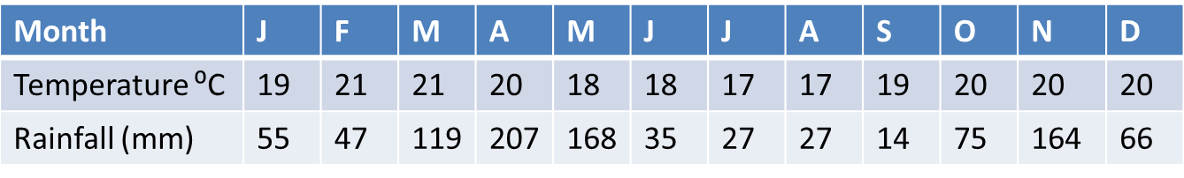
Table: This is data that appears in an organized manner in form of a table e.g. temperature and rainfall for town A and population structure for school Z.
Temperature and rainfall for town A
Population structure for school Z
Form | Boys | Girls | Total
1 | 64 | 35 | 99
2 | 82 | 44 | 126
3 | 53 | 27 | 80
4 | 46 | 28 | 74

Slide 25
Merits of using statistical tables
Demerits of using statistical tables
It is easy to obtain accurate data
It facilitates accurate and rapid reading of the data
Use of tables saves on space and time since data is summarized
Data is easily understood since tables show it in a clear manner
It may be difficult to read and interpret if many values are used
It takes a longer time to interpret data
Tables are not appealing to the eye
Comparison of data between rows and columns is difficult where numerous figures are used

Slide 26
B. A GRAPH
It is a planned drawing consisting of a line, lines or bars showing how two or more sets of values are related to one another.
Independent variables are plotted on the x-axis e.g. time, distance since they change regularly
Dependent variables are plotted on the y-axis e.g. temperature, rainfall since they change more irregularly

Slide 27
1. A SIMPLE LINE GRAPH
It is a one dimensional diagram that shows the relationship between two variables where the variables are represented by a line or a smooth curve
Construction of a line graph
Draw the x and y axis and choose the scale for both axis
Mark the axes at the desired intervals with the corresponding values and mark the zero mark
Plot the values and join the plotted points using a sharp pencil

Slide 28
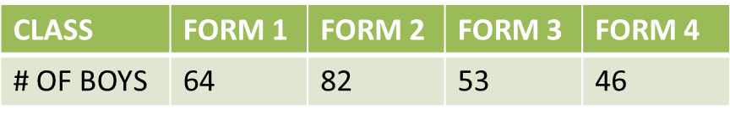
Vertical scale: 1cm reps 10 boys

Slide 29
Merits of line graphs
Demerits of line graphs
They are simple to construct
They are simple to interpret
The variations are clear over a given period of time
Intermediate values can be estimated
It is easy to read the values against the plotted points
They don’t show comparisons between two or more sets of data
It is difficult to obtain exact values from the graph through interpolation
Choice of a poor vertical scale may cause exaggerated fluctuation of values
It may give a false impression on continuity of data

Slide 30
2. A SIMPLE BAR GRAPH
It is a statistical diagram on which quantities are represented by a series of columns. It is also called a histogram/bar chart.
Construction of bar graphs
Choose the suitable scale and draw the x and y-axis
Ensure the bars drawn have uniform width
Bars can be shaded
Have a title for the bar graph

Slide 31
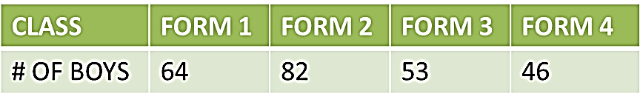

Slide 32

Merits of using simple bar graphs
Demerits of using simple bar graphs
They are easy to draw
The bars appeal to the eye
They give a clear visual impression
It draws attention to individual amounts that make up the variety
It is unsuitable for continuous data
It is difficult to get intermediate values from the graph
Poor choice of vertical scale may lead to exaggeration of length of bars
They show variation over time

Slide 33
3. A Combined line and bar graph
It is a combination of the line and bar graphs and is used to show the relationship between two types of data especially temperature and rainfall.
Construction of a polygraph
Draw the x and the y-axis
Plot the temperature on the right hand side of the graph
Choose a suitable scale for temperature and rainfall but scale for temperature doesn’t start at zero but immediately above or below the highest value for the rainfall.

Slide 34

Temperature and rainfall for town A
15

Slide 35
Merits of using a polygraph
Demerits of using a polygraph
It is easy to construct
The bars and the line are appealing to the eye
It is easy to read the values against the plotted points
Relationship between temperature and rainfall can easily be read off the graph
Characteristics of climate can be derived
Temperature line sometimes crosses the bars
The graph doesn’t show the relationship between the same type of data

Slide 36
Assignment 1

Slide 37
ASSIGNMENT 2
Month | J | F | M | A | M | J | J | A | S | O | N | D
Temp in ⁰C | 24 | 24 | 23 | 22 | 19 | 17 | 17 | 18 | 19 | 20 | 22 | 23
Rainfall in mm | 109 | 122 | 130 | 76 | 52 | 34 | 28 | 38 | 70 | 108 | 121 | 120
The table above shows rainfall and temperature figures of station in Africa.
(i) On the graph paper provided, draw a bar and line graph to represent the rainfall and temperature figures. (Use a vertical scale of 1 cm to represent 10mm and 1cm to represent 5ᵒC). (10 marks)
(ii) Describe the rainfall pattern of the station. (4marks)
Notes:
The table above shows rainfall and temperature figures of station in Africa
(i) On the graph paper provided, draw a bar and line graph to represent the rainfall and temperature figures. (Use a vertical scale of 1 cm to represent 10mm and 1cm to 5ᵒC to represent temperature) (10mks)
(ii) Describe the rainfall pattern of the station (4mks)

Slide 38
4. A wind Rose
A wind rose is a chart on which data on wind direction for a period of time is recorded e.g. a month
It has a central part which is octagon in shape
Each side of the octagon represents one of the eight cardinal points of the compass
The columns are of equal width but vary in length depending on the frequency of wind direction during a given period
Construction
Draw an octagon at the center of the paper about 1cm-1.5cm
Choose a suitable scale to represent the data in the frequency table so as to determine the length
The bars should be drawn at right angle in proportion to the number of times the wind blew from.

Slide 39




Direction N NE E SE S SW W NW Calm Total no. of days of wind no. of days 4 5 7 3 2 1 2 5 2 31
N
Scale
1 cm reps. 1 day

Slide 40
Merits of using a wind rose
Demerits of using a wind rose
It is easy to construct
It gives a good visual impression
It is easy to read and interpret
Values are difficult to extract because they involve measuring
It is difficult to determine the exact time/day the wind blew from a particular direction
It doesn’t show wind speed

Slide 41
Importance of studying statistics
Valid conclusions can be made between two varying quantities.
Saves time and space due to the summarized information.
Future trend can be predicted e.g. data on climate.
Assists in planning at local, national and international levels.
It shows changes through time i.e. decline or improvement.
Comparisons can be made from the statistical data.

Slide 42
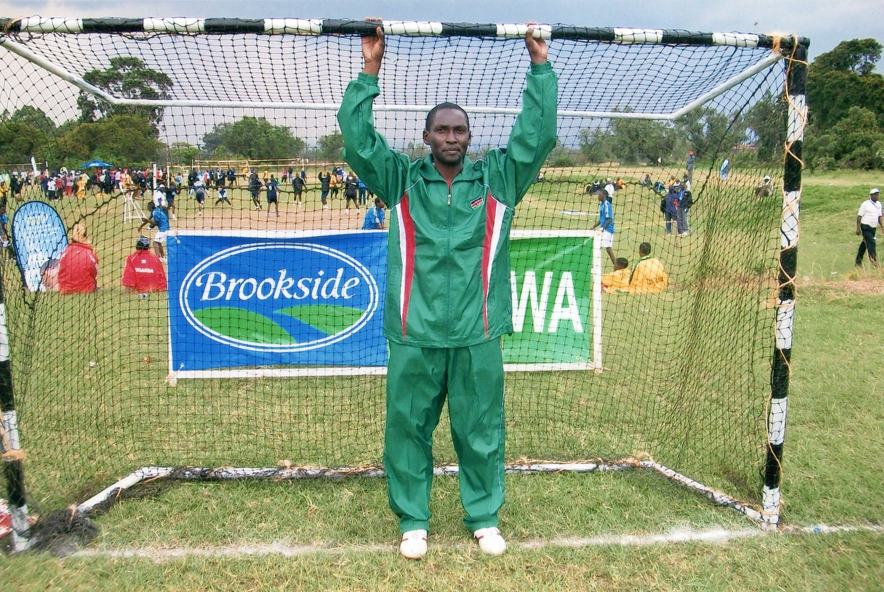
The end

